Slide 1

LIDAR SENSOR

Slide 2
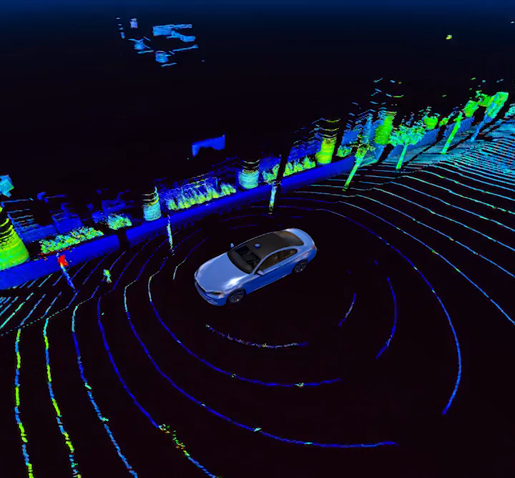
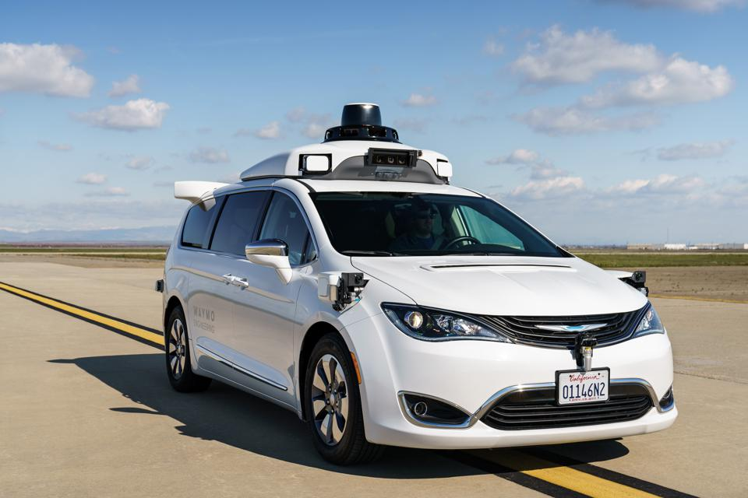
Light Detection and Ranging
An Eye for self driving cars.
360 degree view
Image reference: https://velodynelidar.com/what-is-lidar/

Slide 3
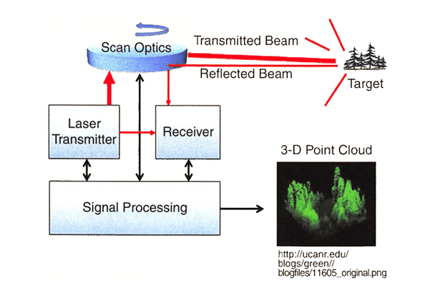
Sensor Working

Slide 4
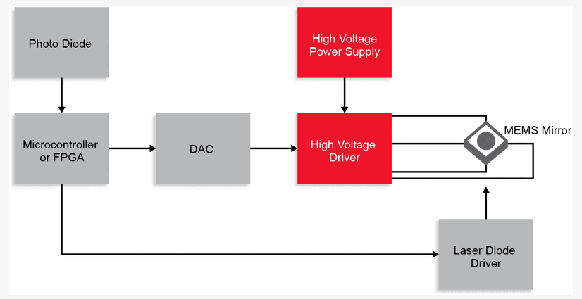
Sensor Working

